Slide 1

University Search App By Major
Text Information Systems Course Project
Joonpyo Jun
joonpyo3@illinois.edu

Slide 2
Purpose
The purpose of this project is to help potential students to select the most appropriate universities in preferred Engineering & Technology majors.
Although there are several university ranking websites, it is hard to find the easy-to-use web application to minimize the searching process.

Slide 3
Dataset
The dataset used in this project is from QS Quacquarelli Symonds Limited, rankings@qs.com in the form of xlsx.
The dataset consists of 5 major fields of study: Arts & Humanities, Engineering & Technology, Life Sciences & Medicine, Natural Sciences, and Social Sciences & Management.
In this project, I focused on “Engineering & Technology” field and its majors under this field, i.e. Computer Science, Chemical Engineering, etc.

Slide 4
Installation & Testing
The project is built on top of npm (node.js) that you must have installed it on your device before running scripts below.
1. Download all source files from the github repository (link is included in the Microsoft CMT).
2. Navigate to /course-project/src then run node server.js. This script runs the server file to host a background server to read and send dataset
3. Navigate to /course-project then run npm install. This installs the node modules that are used in this project.
4. Run npm start. If npm start does not work, try npm build then run the npm start again.
5. If you need or want more detailed procedure, please visit https://reactjs.org/docs/getting-started.html.

Slide 5
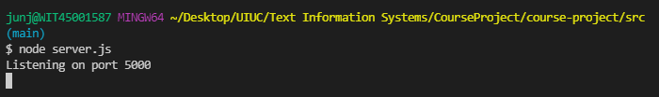
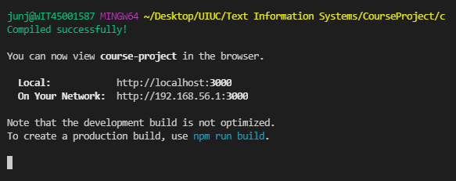
Use case #1
1. Run node server.js to host a local server
2. Run npm start to start the main application
This will open a page with the application on your default browser in about 10-15 seconds.

Slide 6
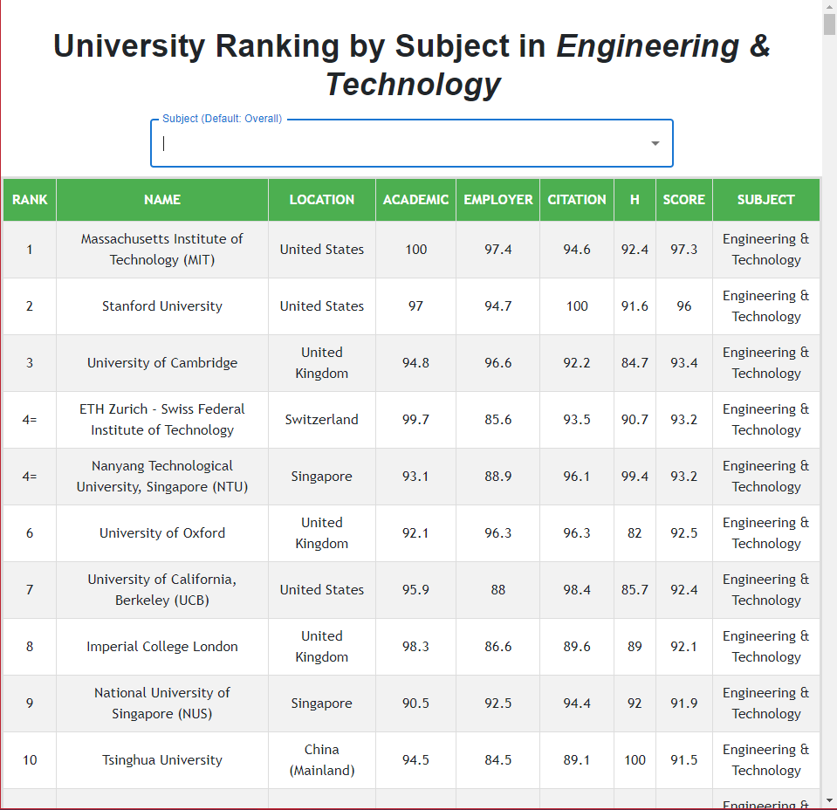
Use case #2
3. This is the first page that you will encounter.
It is straightforward that you can start searching for the major that you are interested in that the result table below will be updated based on your choice.
The default table is for general “Engineering & Technology” field of study.

Slide 7
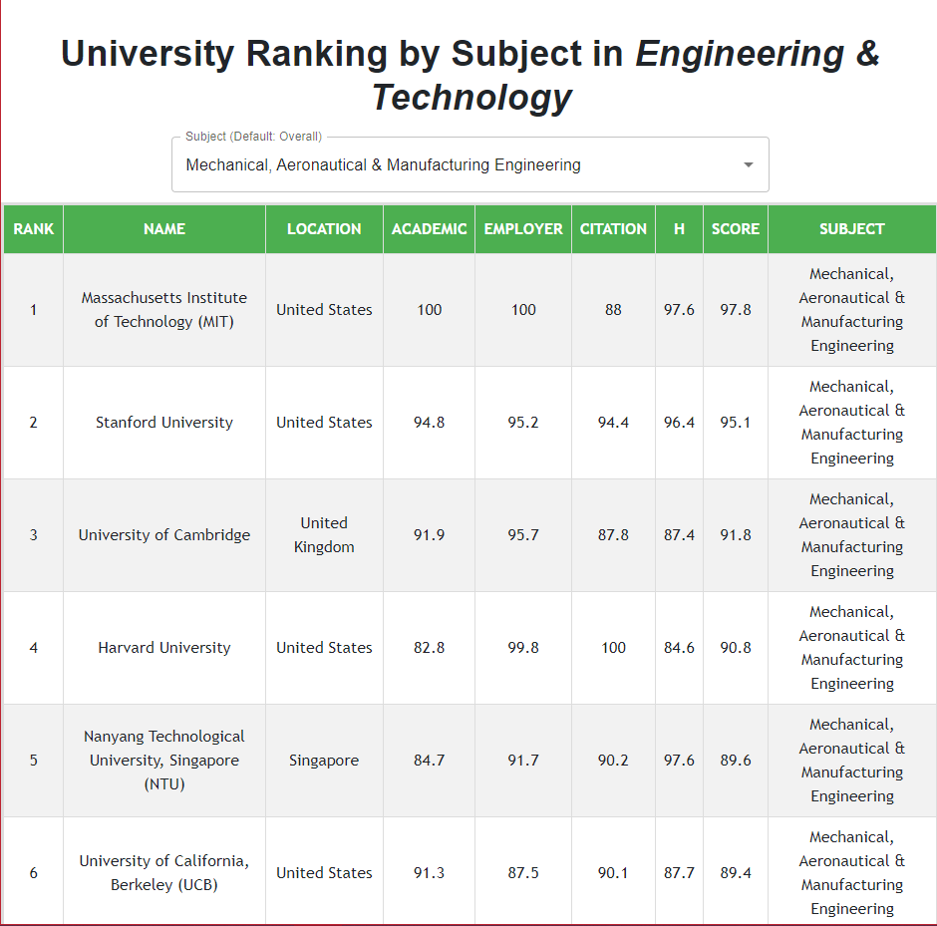
Use case #3
4. This is the test case: I chose “Mechanical, Aeronautical & Manufacturing Engineering” then the result table below is updated with corresponding rankings of universities around the world that offer strong courses in this major.

